Slide 1
Your Data on Cloud
T.N.C.Venkata Rangan
CEO, Vishwak Solutions
www.venkatarangan.com/blog

Slide 2
Session Objectives
Understand the major parts of Windows Azure Storage
Experience building an application with Windows Azure Storage services
Overview of SQL Azure
Overview of “Dallas” Information as a Service

Slide 3
Windows Azure for Application Developers
SDK
Portal
Hosted
Service
Storage
Develop
Deploy
Run

Slide 4
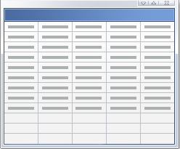
Storage
Storage
Queue
Blob
Account
Tables

Slide 5
Fundamental Storage Abstractions
Tables – Provide structured storage. A Table is a set of entities, which contain a set of properties
Queues – Provide reliable storage and delivery of messages for an application
Blobs – Provide a simple interface for storing named files along with metadata for the file
Drives – Provides durable NTFS volumes for Windows Azure applications to use (new)
5

Slide 6
Windows Azure Storage Account
User creates a globally unique storage account name
Can choose geo-location to host storage account
“US Anywhere”, “US North Central”, “US South Central”, East Asia, South East Asia and more …
Can co-locate storage account with compute account
Receive a 256 bit secret key when creating account
Storage Account Capacity at Commercial Availability
Each storage account can store up to 100 TB
Default limit of 5 storage accounts per subscription
Demo

Slide 7
Tables

Slide 8
Windows Azure Tables
Provides Structured Storage
Massively Scalable Tables
Billions of entities (rows) and TBs of data
Can use thousands of servers as traffic grows
Highly Available & Durable
Data is replicated several times
Familiar and Easy to use API
ADO.NET Data Services – .NET 3.5 SP1
.NET classes and LINQ
REST – with any platform or language
8

Slide 9
Table Storage Concepts
Accounts
Tables
Entities
Email =…
Name = …
Users
Email =…
Name = …
moviesonline
Genre =…
Title = …
Movies
Genre =…
Title = …
9

Slide 10
Required Entity Properties
PartitionKey & RowKey
Uniquely identifies an entity
Defines the sort order
Use them to scale your application
Timestamp
Read only
Optimistic Concurrency
10

Slide 11
Partitions and Partition Ranges
PartitionKey (Category) | RowKey (Title) | Timestamp | ReleaseDate
Action | Fast & Furious | … | 2009
Action | The Bourne Ultimatum | … | 2007
… | … | … | …
Animation | Open Season 2 | … | 2009
Animation | The Ant Bully | … | 2006
… | … | … | …
Comedy | Office Space | … | 1999
… | … | … | …
SciFi | X-Men Origins: Wolverine | … | 2009
… | … | … | …
War | Defiance | … | 2008
PartitionKey (Category) | RowKey (Title) | Timestamp | ReleaseDate
Action | Fast & Furious | … | 2009
Action | The Bourne Ultimatum | … | 2007
… | … | … | …
Animation | Open Season 2 | … | 2009
Animation | The Ant Bully | … | 2006
Server A
Table = Movies
[Action - Comedy)
Server A
Table = Movies
PartitionKey (Category) | RowKey (Title) | Timestamp | ReleaseDate
Comedy | Office Space | … | 1999
… | … | … | …
SciFi | X-Men Origins: Wolverine | … | 2009
… | … | … | …
War | Defiance | … | 2008
Server B
Table = Movies
[Comedy- Western)
11

Slide 12
Table Operations
Table
Create
Query
Delete
Entities
Insert
Update
Merge – Partial Update
Replace – Update entire entity
Delete
Query
Entity Group Transaction (new)

Slide 13
Queues

Slide 14
Windows Azure Queues
Queue are performance efficient, highly available and provide reliable message delivery
Simple, asynchronous work dispatch
Programming semantics ensure that a message can be processed at least once
Access is provided via REST
14

Slide 15
Queue Storage Concepts
Accounts
Queues
Messages
128 x 128 http://...
thumbnailjobs
256 x 256 http://...
sally
http://...
traverselinks
http://...
15

Slide 16
Account, Queues and Messages
An account can create many queues
Queue Name is scoped by the account
A Queue contains messages
No limit on number of messages stored in a queue
Set a limit for message expiration
Messages
Message size <= 8 KB
To store larger data, store data in blob/entity storage, and the blob/entity name in the message
Message now has dequeue count
16

Slide 17
Queue Operations
Queue
Create Queue
Delete Queue
List Queues
Get/Set Queue Metadata
Messages
Add Message (i.e. Enqueue Message)
Get Message(s) (i.e. Dequeue Message)
Peek Message(s)
Delete Message
17

Slide 18
How Queue Works
Producers
Consumers
P₂
C₁
1. GetMessage(Q, 30 s) → msg 1
4
0
3
3
0
2
1
2
1
2
1
2
0
1
1
1
1
1
1
1
0
C₂
P₁
2. GetMessage(Q, 30 s) → msg 2
18

Slide 19
How Queue Works
Producers
Consumers
1
1
P₂
C₁
1. GetMessage(Q, 30 s) → msg 1
5. C₁ crashed
4
0
3
0
2
1
1
1
1
2
1
1
3
1
2
6. msg1 visible 30 s after Dequeue
2
1
C₂
P₁
2. GetMessage(Q, 30 s) → msg 2
3. C2 consumed msg 2
4. DeleteMessage(Q, msg 2)
7. GetMessage(Q, 30 s) → msg 1
19

Slide 20
Blobs

Slide 21
Blob Storage Concepts
Account
Container
Blob
PIC01.JPG
images
PIC02.JPG
sally
movies
MOV1.AVI

Slide 22
Blob Features and Functions
Store Large Objects (100s of GBs in size)
Associate Metadata with Blob
Metadata is <name, value> pairs, Up to 8KB per blob
Set/Get with or separate from blob data bits
Standard REST Interface
PutBlob
Inserts a new blob, overwrites the existing blob
GetBlob
Get whole blob or a specific range
DeleteBlob
CopyBlob (new)
SnapshotBlob (new)
LeaseBlob (new)

Slide 23
Two Types of Blobs Under the Hood
Block Blob
Targeted at streaming workloads
Each blob consists of a sequence of blocks
Each block is identified by a Block ID
Size limit 200GB per blob
Page Blob (new)
Targeted at random read/write workloads
Each blob consists of an array of pages
Each page is identified by its offset from the start of the blob
Size limit 1TB per blob

Slide 24
Blob Namespace
Blob URL
http://<Account>.blob.core.windows.net/<Container>/<BlobName>
Example:
Storage Account – sally
Container – music
BlobName – rock/rush/xanadu.mp3
http://sally.blob.core.windows.net/music/rock/rush/xanadu.mp3

Slide 25
Tables, Blob and Queue
Guest Book
Demo

Slide 26
Windows Azure XDrive (new)
Provides a durable NTFS volume for Windows Azure applications to use
Use existing NTFS APIs to access a durable drive
Durability and survival of data on application failover
Enables migrating existing NTFS applications to the cloud
A Windows Azure Drive is a Page Blob
Example, mount Page Blob as X:\
http://<accountname>.blob.core.windows.net/<containername>/<blobname>
All writes to drive are made durable to the Page Blob
Drive made durable through standard Page Blob replication
Drive persists even when not mounted as a Page Blob

Slide 27
Windows Azure Content Delivery Network (new)
Scenario
Frequently accessed blobs
Accessed from around the world
Desire
Same experience for users no matter how far they are from the geo-location where the storage account is hosted
Windows Azure Content Delivery Network (CDN) provides high-bandwidth global blob content delivery
18 locations globally (US, Europe, Asia, Australia and South America), and growing
Blob service URL vs CDN URL:
Windows Azure Blob URL: http://sally.blob.core.windows.net/
Windows Azure CDN URL: http://<guid>.vo.msecnd.net/
Custom Domain Name for CDN: http://events.cohowinery.com/

Slide 28
SQL Azure

Slide 29
SQL Azure
SQL Azure delivers the value of hosted relational database with the differentiated benefits of a managed database as a utility
Hosted RDBMS
Managed RDBMS
SQL query processor
Familiar relational model
Transactions
Ecosystem of familiar development and management tools
Low-friction provisioning
High scale
Multi-tenant
Self-management
Automatic HA and DR

Slide 30
“Dallas”

Slide 31
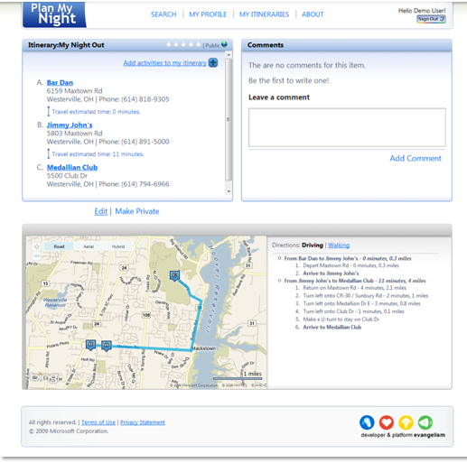
Planning a Night Out Scenario
Show times
Predicative parking
Restaurant reviews
Real-time weather
…

Slide 32
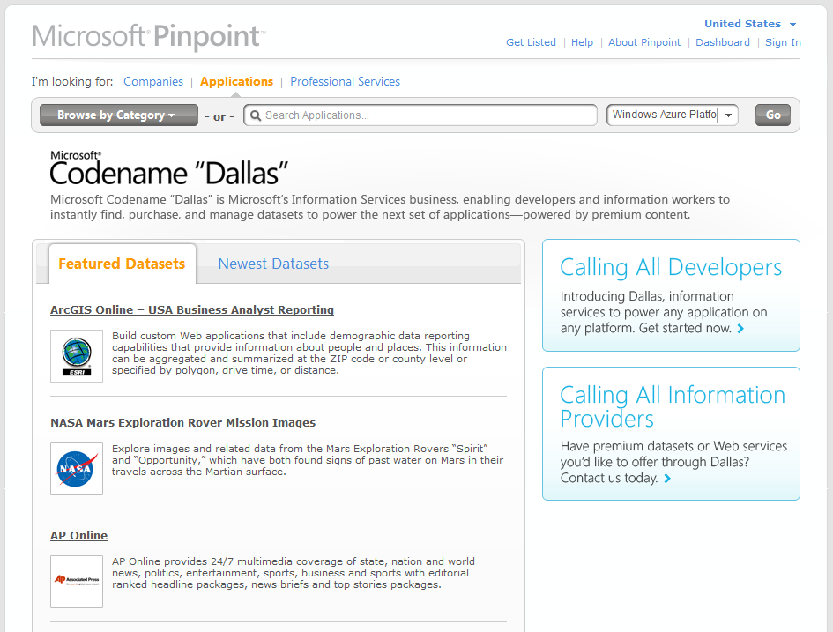
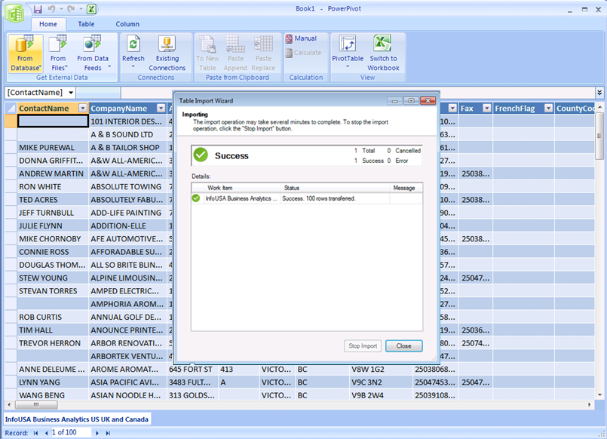
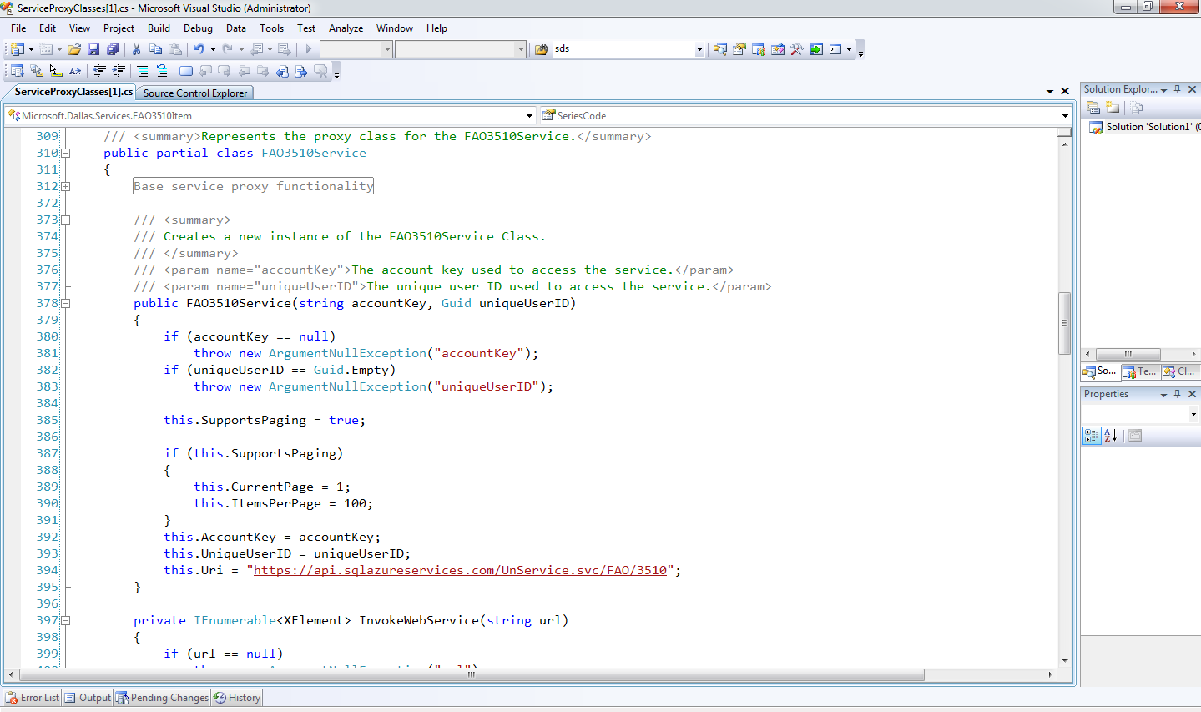
Microsoft Codename “Dallas” Information Service
Authoritative data, weather, demographics, financial, images, community reviews…
Commercial & trusted public domain
Relational, blob, web services

Slide 33
Summary
Highly scalable & redundant storage model
Pay as you go!
Same Development Tools and Experience

Slide 34
References
Windows Azure Platform Training Kit
Windows Azure Samples
code.msdn.microsoft.com/windowsazuresamples

